Slide 1
Storage in Cloud
Storage options in the cloud
Structured and unstructured storage in the cloud
unstructured storage using Cloud Storage
SQL managed services, Exploring Cloud SQL
Cloud Spanner as a managed service
NoSQL managed service options
Cloud Datastore, a NoSQL document store
Cloud Bigtable as a NoSQL option

Slide 2
1.Microsoft OneDrive is a file hosting service that Microsoft operates. First launched in August 2007, it enables registered users to share and synchronize their files. OneDrive also works as the storage back-end of the web version of Microsoft Office.
2. IDrive Inc. is a technology company that specializes in data backup applications. Its flagship product is IDrive, an online backup service available to Windows, Mac, Linux, iOS and Android users
3. Dropbox is a file hosting service operated by the U.S. that offers cloud storage, file synchronization, personal cloud, and client software

Slide 3
Difference between Cloud Storage and Traditional Storage
Cloud Storage :
Cloud storage is the storage option in which we use remote drives to store the data at the cloud location used by the client. It also uses the network to store the data to an off-site server which is owned by the service provider. User uses this storage options for capacity, bandwidth, and remote access.
Features of Cloud Storage :
Cloud storage offers a variety of data security options.
These storage options are easily accessible with every internet-connected device.
Faults are easily traceable in cloud-based storage.
Setting up and cloud storage is way more effective and easy than traditional ones.
2. Traditional Storage :
Traditional storage is the storage option in which we use local physical drives to store the data at the primary location of the client. User generally uses the disk-based hardware to store data and these are used for copying, managing, and integrating the data to software.
Features of Traditional Storage :
Traditional storage is fast as they do not rely on internet speeds.
Security can be manually set up by the user in traditional storage options.
Users can recover the data anytime without having accessibility issues.
On-site backup and modification are easy.

Slide 4
Differences between Cloud Storage and Traditional Storage :
Parameters | Cloud Storage | Traditional Storage
Performance | Cloud storage perform better due to using NoSQL. | Traditional storage perform a bit slow as compared to cloud.
Maintenance | This type of storage options are easy to maintain as you use and service provider takes care of maintenance. | This storage are heavy to manage as you need to manually run through maintenance tools.
Reliability | Cloud storage are highly reliable as it takes less time to get under functioning. | Traditional storage requires high initial effort and is less reliable.
File Sharing | Cloud storage supports file sharing dynamically as it can be shared anywhere with network access. | Traditional storage requires physical drives to share data and network is to established between both.
File access time | In this system file access time is dependent on the network speed. | This system has fast access time as compared to cloud storage.
Security | Cloud storage are more secure as it integrates with many security tools. | Traditional storage are secure with they can get attacked easily through virus and malwares.
Applications | Amazon Drive, Dropbox, AutoSync are some applications of cloud storage. | HHD, SSD and Pendrives are some applications of traditional storage.

Slide 5
What is Cloud Storage?
Cloud storage is essentially a virtual locker where we can remotely store any of our data. When we upload a file to cloud base server like Google Drive, OneDrive or iCloud that file gets copied over the Internet into a data server-that are actual physical spaces where companies store files on multiple hard drives. Most companies have hundreds of these servers known as ‘server farms’ spanning across multiple locations. So, if our data gets somehow lost we will not lose our data because it will be backed up by another location. This is known as redundancy which keeps our data safe from being lost.
Where does our Cloud Storage reside?
Despite being stored in the cloud, our data still needs to be physically stored somewhere. Big companies providing this service need to have huge servers dedicated to storing our data though the place where this data is stored isn’t specified by these providers.
For example, the provider may be based in the US but their servers might be in China or the UK or anywhere else in the world. Some companies even outsource their server farms to satellite locations in order to reduce costs. So, it’s very difficult to know where our data actually resides.

Slide 6
Is Cloud Storage Secure?
Even if we feel free to store our data in the cloud but how do we know that our data is truly safe in the hands of a cloud provider?
Reliability and Security are two biggest concerns that these companies address the most.
Cloud Storage Vs. Cloud Computing
Cloud storage is simply storing the data via Internet to cloud-based servers. Once the data is stored in the cloud we can access it anywhere through Internet on multiple devices.
On the other hand, Cloud computing is linked with cloud storage in that we have to move data to the cloud before we can make use of cloud computing systems. Once the data is moved to the cloud, we can process it into useful material and send it back to us.
An example of Cloud Computing is Software as a Service (SaaS), where we input data on software and the data is transformed remotely through a software interface without our computer being involved.
Cloud storage needs more storage space. However, Cloud computing needs robust processors to keep applications running smoothly.
Cloud storage is simply a data storage and sharing medium while cloud computing gives us the ability to remotely work on and transform data. For example, coding an application remotely.
Rolling out upgrades, updates and patches is fast, simple and easy with cloud computing since it only needs to be performed on the virtual server not on every single device.

Slide 7
Cloud Storage is a service that allows to save data on offsite storage system managed by third-party and is made accessible by a web services API.
Storage Devices
Storage devices can be broadly classified into two categories:
Block Storage Devices
File Storage Devices
Block Storage Devices
The block storage devices offer raw storage to the clients. These raw storage are partitioned to create volumes.

Slide 8
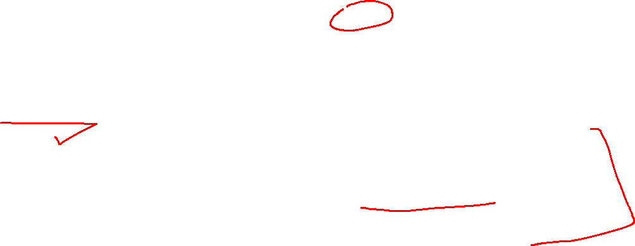
File Storage Devices
The file Storage Devices offer storage to clients in the form of files, maintaining its own file system. This storage is in the form of Network Attached Storage (NAS).
Cloud Storage Classes
Cloud storage can be broadly classified into two categories:
1.Unmanaged Cloud Storage
Unmanaged cloud storage means the storage is preconfigured for the customer. The customer can neither format, nor install his own file system or change drive properties.
2. Managed Cloud Storage
Managed cloud storage offers online storage space on-demand. The managed cloud storage system appears to the user to be a raw disk that the user can partition and format.

Slide 9
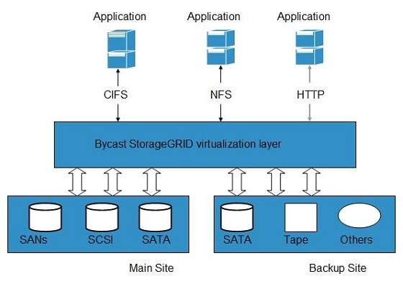

Slide 10
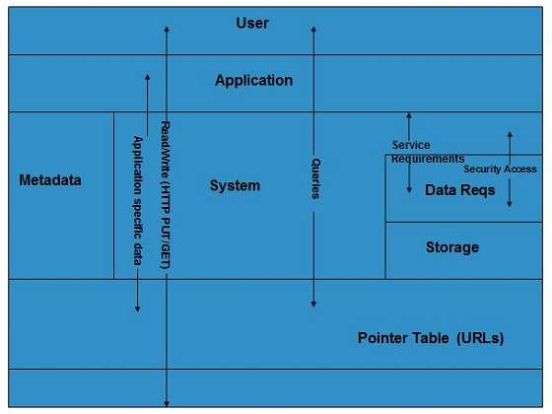
Virtual Storage Containers
The virtual storage containers offer high performance cloud storage systems. Logical Unit Number (LUN) of device, files and other objects are created in virtual storage containers. Following diagram shows a virtual storage container, defining a cloud storage domain:

Slide 11
Challenges
Storing the data in cloud is not that simple task. Apart from its flexibility and convenience, it also has several challenges faced by the customers. The customers must be able to:
Get provision for additional storage on-demand.
Know and restrict the physical location of the stored data.
Verify how data was erased.
Have access to a documented process for disposing of data storage hardware.
Have administrator access control over data.

Slide 12
Which databse?

Slide 13
Relational databases
In relational databases information is stored in tables, rows and columns, which typically works best for structured data.
As a result they are used for applications in which the structure of the data does not change often.
SQL (Structured Query Language) is used when interacting with most relational databases.
They offer ACID consistency mode for the data, which means:
Atomic: All operations in a transaction succeed or the operation is rolled back.
Consistent: On the completion of a transaction, the database is structurally sound.
Isolated: Transactions do not contend with one another. Contentious access to data is moderated by the database so that transactions appear to run sequentially.
Durable: The results of applying a transaction are permanent, even in the presence of failures.
Because of these properties, relational databases are used in applications that require high accuracy and for transactional queries such as financial and retail transactions.
For example: In banking when a customer makes a funds transfer request, you want to make sure the transaction is possible and it actually happens on the most up-to-date account balance, in this case an error or resubmit request is likely fine

Slide 14
Relational databases
There are three relational database options in Google Cloud:
Cloud SQL: Provides managed MySQL, PostgreSQL and SQL Server databases on Google Cloud. It reduces maintenance cost and automates database provisioning, storage capacity management, back ups, and out-of-the-box high availability and disaster recovery/failover. For these reasons it is best for general-purpose web frameworks, CRM, ERP, SaaS and e-commerce applications.
Cloud Spanner: Cloud Spanner is an enterprise-grade, globally-distributed, and strongly-consistent database that offers up to, 99.999% availability ational horizontal scale. It is a unique database that combines ACID transactions, SQL queries, and relational structure with the scalability.As a result, Spanner is best used for applications such as gaming, payment solutions, global financial ledgers, retail banking and inventory management that require ability to scale limitlessly with strong-consistency and high-availability.
Bare Metal Solution: Provides hardware to run specialized workloads with low latency on Google Cloud. This is specifically useful if there is an Oracle database that you want to lift and shift into Google Cloud. This enables data center retirements and paves a path to modernize legacy applications.

Slide 15
2.Non-relational databases
Non-relational databases (or NoSQL databases) store complex, unstructured data in a non-tabular form such as documents.
Non-relational databases are often used when large quantities of complex and diverse data need to be organized, or where the structure of the data is regularly evolving to meet new business requirements.
Unlike relational databases, they perform faster because a query doesn’t have to access several tables to deliver an answer, making them ideal for storing data that may change frequently or for applications that handle many different kinds of data.
For example, an apparel store might have a database in which shirts have their own document containing all of their information, including size, brand, and color with room for adding more parameters later such as sleeve size, collars, and so on.

Slide 16
Non-relational databases
Qualities that make NoSQL databases fast:
Typically, they are optimized for a specific workload pattern (i.e., key-value, graph, wide-column)
Horizontal scaling, usually using range or hashed distributions.
Eventual consistency: many NoSQL stores usually exhibit consistency at some later point (e.g., lazily at read time). However, Firestore uniquely offers strong global consistency.
Transactions: a majority of NoSQL stores don't support cross shard transactions or flexible isolation modes. However, Firestore uniquely offers ACID transactions across shards with serializable isolation.

Slide 17
Non-relational databases
Non-relational databases can store a variety of unstructured data such as documents, key-value, graphs, wide columns, and more. Here are your non-relational database options in Google Cloud:
Document databases: Store information as documents (in formats such as JSON and XML). For example: Firestore
Key-value stores: Group associated data in collections with records that are identified with unique keys for easy retrieval. Key-value stores have just enough structure to mirror the value of relational databases while still preserving the benefits of NoSQL. For example: Bigtable, Memorystore
In-memory database: Purpose-built database that relies primarily on memory for data storage. These are designed to attain minimal response time by eliminating the need to access disks. They are ideal for applications that require microsecond response times and can have large spikes in traffic. For example: Memorystore
Wide-column databases: Use the tabular format but allow a wide variance in how data is named and formatted in each row, even in the same table. They have some basic structure while preserving a lot of flexibility. For example: Bigtable
Graph databases: Use graph structures to define the relationships between stored data points; useful for identifying patterns in unstructured and semi-structured information. For example: JanusGraph

Slide 18
There are three non-relational databases in Google Cloud:
Firestore: Is a serverless document database which scales on demand, is strongly-consistent, offers up to 99.999% availability and acts as a backend-as-a-service. It is DBaaS that is optimized for building applications. It is perfect for all general purpose uses cases such as ecommerce, gaming, IoT and real time dashboards. With Firestore, users can interact with and collaborate on live and offline data making it great for real-time application and mobile apps.
Cloud Bigtable: Cloud Bigtable is a sparsely populated table that can scale to billions of rows and thousands of columns, enabling you to store terabytes or even petabytes of data. It is ideal for storing very large amounts of single-keyed data with very low latency. It supports high read and write throughput at sub-millisecond latency, and it is an ideal data source for MapReduce operations. It also supports the open-source HBase API standard to easily integrate with the Apache ecosystem including HBase, Beam, Hadoop and Spark along with Google Cloud ecosystem.
Memorystore: Memorystore is a fully managed in-memory data store service for Redis and Memcached at Google Cloud. It is best for in-memory and transient data stores and automates the complex tasks of provisioning, replication, failover, and patching so you can spend more time coding. Because it offers extremely low latency and high performance, Memorystore is great for web and mobile, gaming, leaderboard, social, chat, and news feed applications.

Slide 19
Google Cloud: Firestore
What is Google Firestore?
Google Firestore, also known as Cloud Firestore is a part of the Google Firebase application development platform. It is fundamentally a cloud-hosted NoSQL database for storing and syncing data. Firestore can be directly accessed by mobile and web applications through native SDKs.
What are the critical features of Google’s Firestore?
– Offline synchronization
– Auto scaling
– Multi-region replication
– Serverless

Slide 20
Pricing Example
Firestore Pricing
Firestore pricing starts at a free of cost plan, which offers limited functionality and features. Users who exceed the storage limits have to pay for their database operations, network bandwidth, and stored data.
The main variables that determine Firestore pricing are:
Database Location
Data Stored
Bandwith
Reads, Writes, and Deletes
For the sake of this example, let’s consider the following assumptions:
US Multi-Region
11GB Data Stored for a one month period
Transfer out 110GB (excluding China/Australia)
150,000 document reads
120,000 document writes
120,000 document deletes
Now, let’s do the math. Pricing information gathered from Firestore Pricing Page.
Data storage charged as follows:
$0.00 for the first GB
$0.18 for the additional GB
So, total is $0.18 x (11-1) = $1.8 for 11GB storage during one month
Transfer out charged as follows:
$0.00 for the first 10 GB
$0.12 for the additional GB
So, total is $0.12 x (110-10) = $12 for 110GB transfer out

Slide 21
Google Cloud: Cloud Bigtable
A fully managed, scalable NoSQL database service for large analytical and operational workloads with up to 99.999% availability.
Consistent sub-10ms latency—handle millions of requests per second
Ideal for use cases such as personalization, ad tech, fintech, digital media, and IoT
Seamlessly scale to match your storage needs; no downtime during reconfiguration
Designed with a storage engine for machine learning applications leading to better predictions
Easily connect to Google Cloud services such as BigQuery or the Apache ecosystem

Slide 22
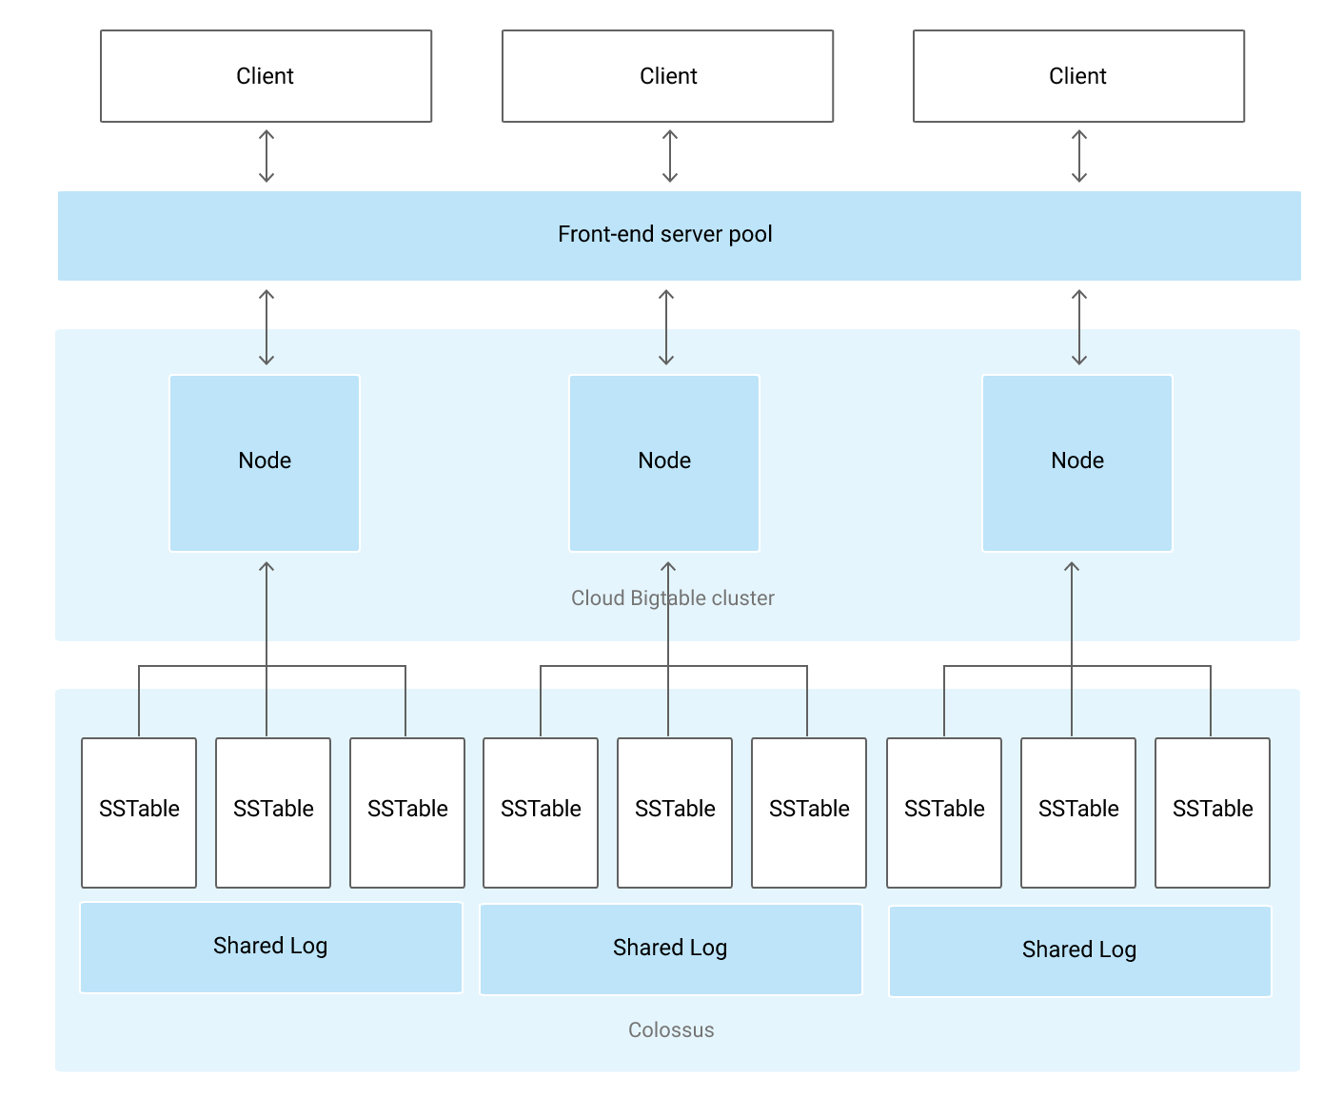
Bigtable Architecture

Slide 23
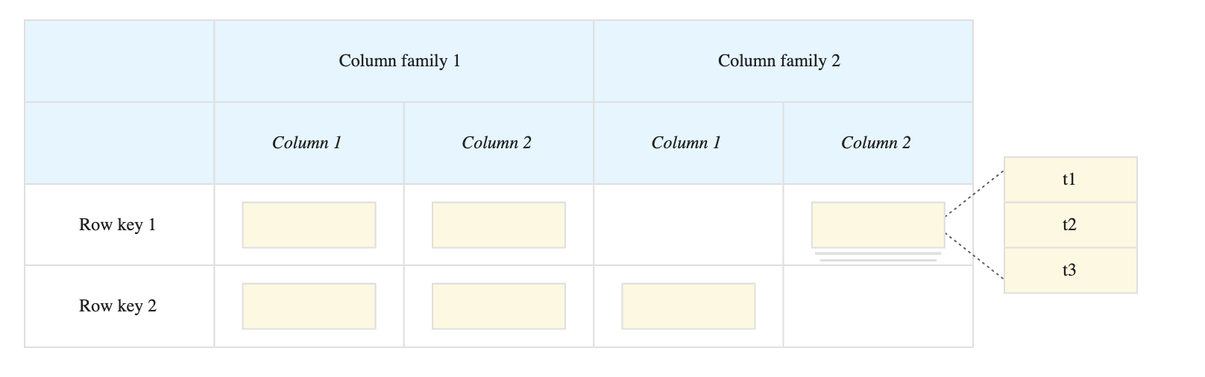
Bigtable Storage Model

Slide 24
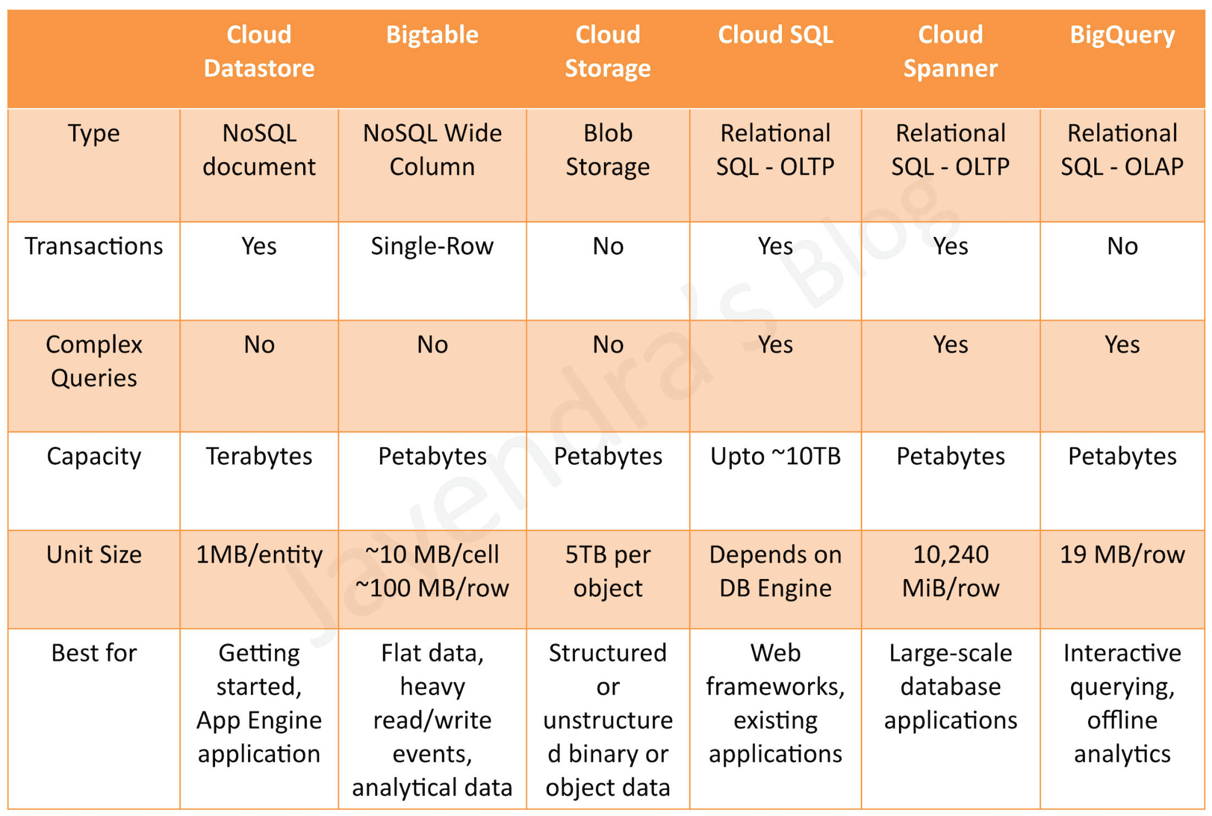

Slide 25
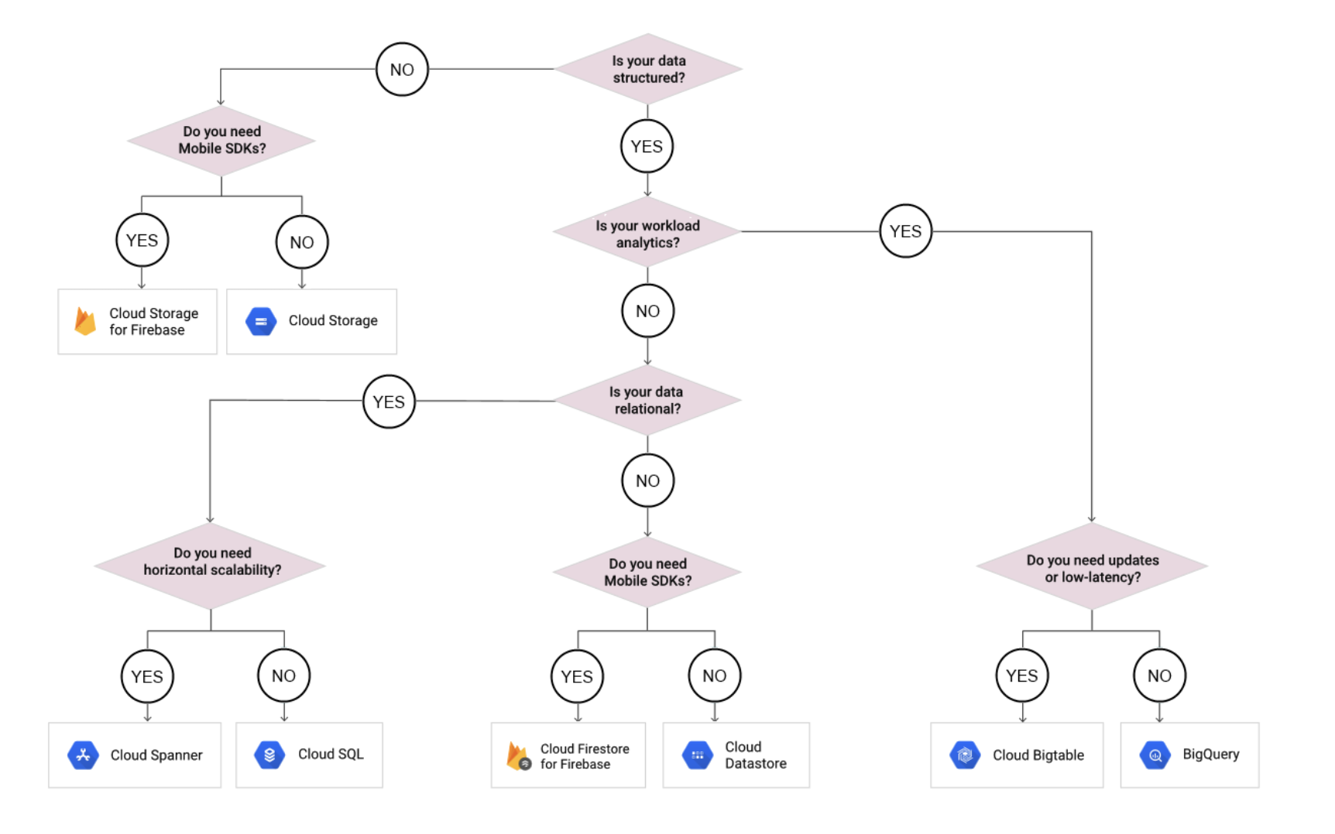

Slide 26
MCQs
Your application is hosted across multiple regions and consists of both relational database data and static images. Your database has over 10 TB of data. You want to use a single storage repository for each data type across all regions. Which two products would you choose for this task? (Choose two)
Cloud Bigtable
Cloud Spanner
Cloud SQL
Cloud Storage

Slide 27
You are building an application that stores relational data from users. Users across the globe will use this application. Your CTO is concerned about the scaling requirements because the size of the user base is unknown. You need to implement a database solution that can scale with your user growth with minimum configuration changes. Which storage solution should you use?
Cloud SQL
Cloud Spanner
Cloud Firestore
Cloud Datastore

Slide 28
Your company processes high volumes of IoT data that are time-stamped. The total data volume can be several petabytes. The data needs to be written and changed at a high speed. You want to use the most performant storage option for your data. Which product should you use?
Cloud Datastore
Cloud Storage
Cloud Bigtable
BigQuery

Slide 29
Your App Engine application needs to store stateful data in a proper storage service. Your data is non-relational database data. You do not expect the database size to grow beyond 10 GB and you need to have the ability to scale down to zero to avoid unnecessary costs. Which storage service should you use?
Cloud Bigtable
Cloud Dataproc
Cloud SQL
Cloud Datastore

Slide 30
A financial organization wishes to develop a global application to store transactions happening from different part of the world. The storage system must provide low latency transaction support and horizontal scaling. Which GCP service is appropriate for this use case?
Bigtable
Datastore
Cloud Storage
Cloud Spanner

Slide 31
You work for a mid-sized enterprise that needs to move its operational system transaction data from an on-premises database to GCP. The database is about 20 TB in size. Which database should you choose?
Cloud SQL
Cloud Bigtable
Cloud Spanner
Cloud Datastore

Slide 32
Bigtable is ideal for applications that need very high throughput and scalability for key/value data, where each value is max. of 10 MB.
Bigtable supports high read and write throughput at low latency and provides consistent sub-10ms latency – handle millions of requests/second
Bigtable is a sparsely populated table that can scale to billions of rows and thousands of columns,
Bigtable supports storage of terabytes or even petabytes of data
Bigtable is not a relational database. It does not support SQL queries, joins, or multi-row transactions.

Slide 33
Fully Managed
Bigtable handles upgrades and restarts transparently, and it automatically maintains high data durability.
Data replication can be performed by simply adding a second cluster to the instance, and replication starts automatically.
Scalability
Bigtable scales linearly in direct proportion to the number of machines in the cluster
Bigtable throughput can be scaled dynamically by adding or removing cluster nodes without restarting

Slide 34
What is Google Cloud Platform (GCP)?
Google Cloud Platform is a set of Computing, Networking, Storage, Big Data, Machine Learning and Management services provided by Google that runs on the same Cloud infrastructure that Google uses internally for its end-user products, such as Google Search, Gmail, Google Photos and YouTube.

Slide 35
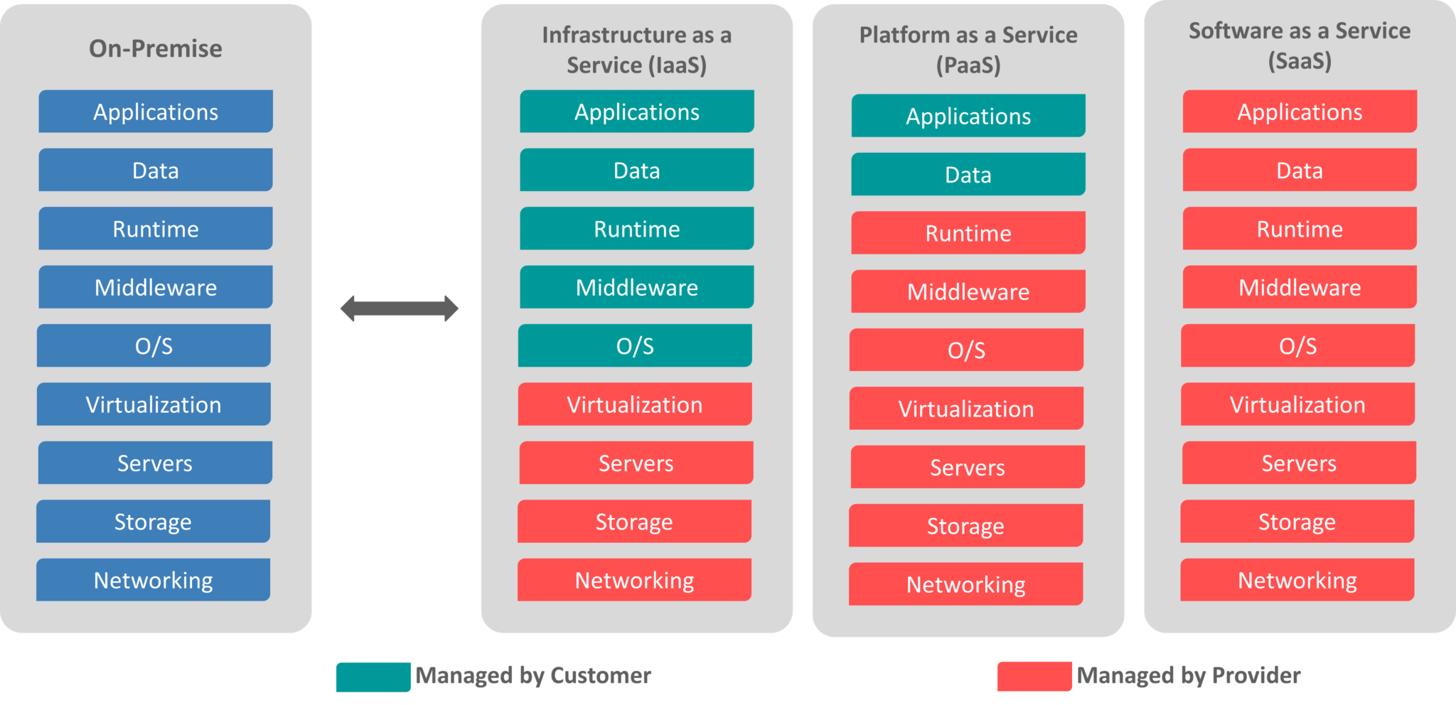

Slide 36
Why Google Cloud Platform?
Now that you have a brief idea of What is Google Cloud Platform and Cloud Computing, let’s understand why one must go for it. Google Cloud Platform, is a suite of cloud computing services that run on the same infrastructure that Google uses internally for its end-user products, such as Google Search, Gmail, Google Photos and YouTube. We all know how big is the database of Gmail, Youtube and Google Search.

Slide 37
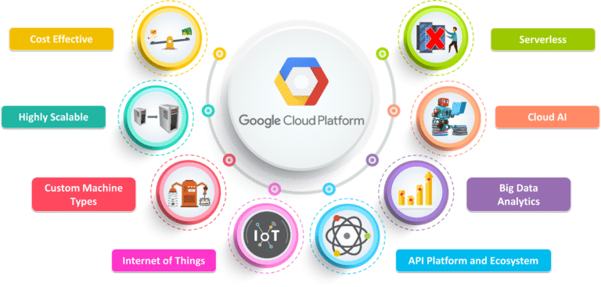

Slide 38
Google Cloud Platform Regions and Zones
Google Cloud Platform services are available in various locations across North America, South America, Europe, Asia, and Australia. These locations are divided into regions and zones. You can choose where to locate your applications to meet your latency, availability and durability requirements.

Slide 39
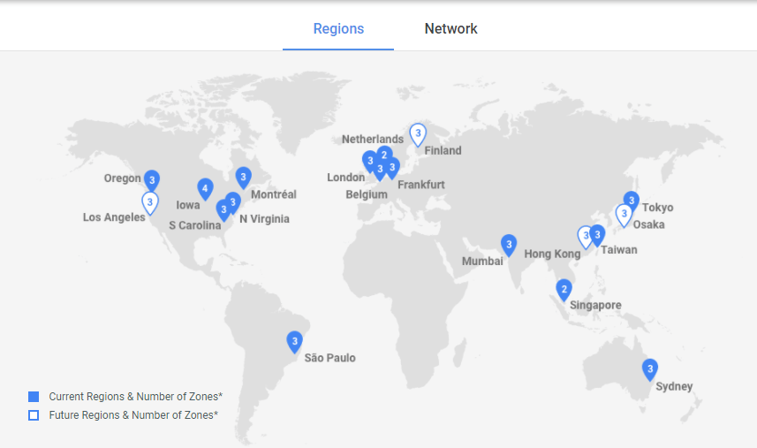

Slide 40
What are Google Cloud Platform (GCP) Services?
Google offers a wide range of Services. Following are the major Google Cloud Services:
Compute
Networking
Storage and Databases
Big Data
Machine Learning
Identity & Security
Management and Developer Tools

Slide 41
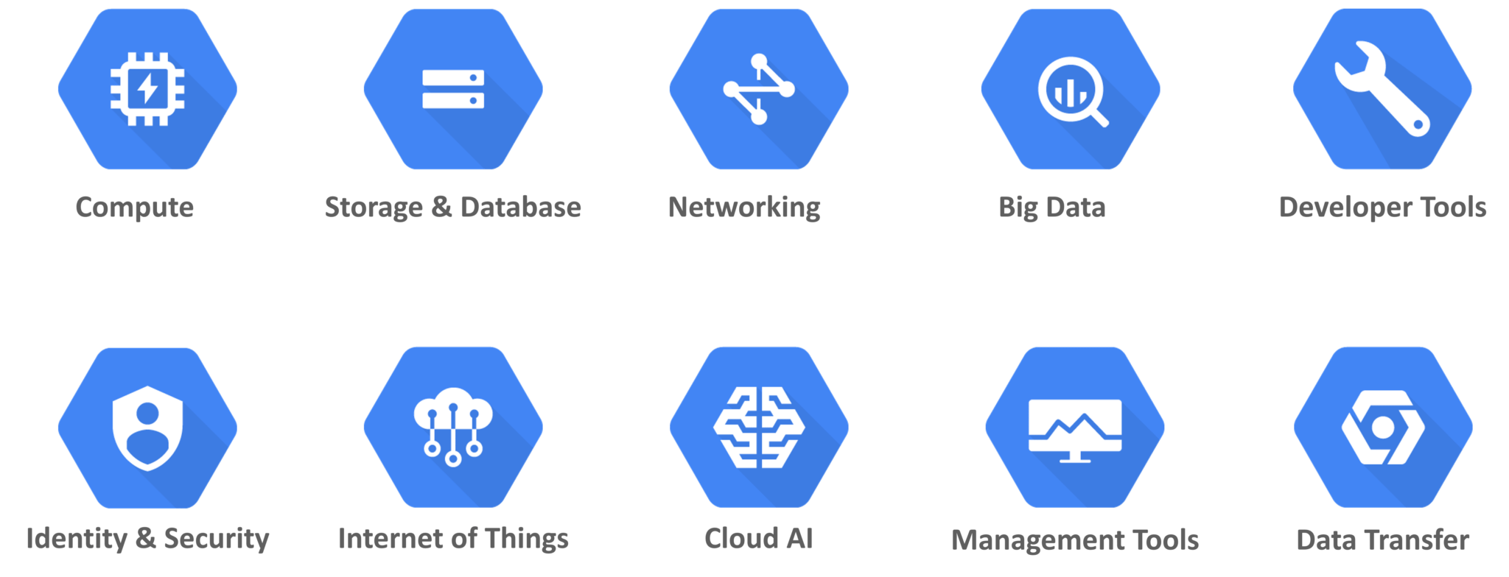

Slide 42
Compute: GCP provides a scalable range of computing options you can tailor to match your needs. It provides highly customizable virtual machines. and the option to deploy your code directly or via containers.
Google Compute Engine
Google App Engine
Google Kubernetes Engine
Google Cloud Container Registry
Cloud Functions
Networking: The Storage domain includes services related to networking, it includes the following services
Google Virtual Private Cloud (VPC)
Google Cloud Load Balancing
Content Delivery Network
Google Cloud Interconnect
Google Cloud DNS
Storage and Databases: The Storage domain includes services related to data storage, it includes the following services
Google Cloud Storage
Cloud SQL
Cloud Bigtable
Google Cloud Datastore
Persistent Disk

Slide 43
Big Data: The Storage domain includes services related to big data, it includes the following services
Google BigQuery
Google Cloud Dataproc
Google Cloud Datalab
Google Cloud Pub/Sub
Cloud AI: The Storage domain includes services related to machine learning, it includes the following services
Cloud Machine Learning
Vision API
Speech API
Natural Language API
Translation API
Jobs API
Identity & Security: The Storage domain includes services related to security, it includes the following services
Cloud Resource Manager
Cloud IAM
Cloud Security Scanner
Cloud Platform Security

Slide 44
Management Tools: The Storage domain includes services related to monitoring and management, it includes the following services
Stackdriver
Monitoring
Logging
Error Reporting
Trace
Cloud Console
Developer Tools: The Storage domain includes services related to development, it includes the following services
Cloud SDK
Deployment Manager
Cloud Source Repositories
Cloud Test Lab

